Slide 1
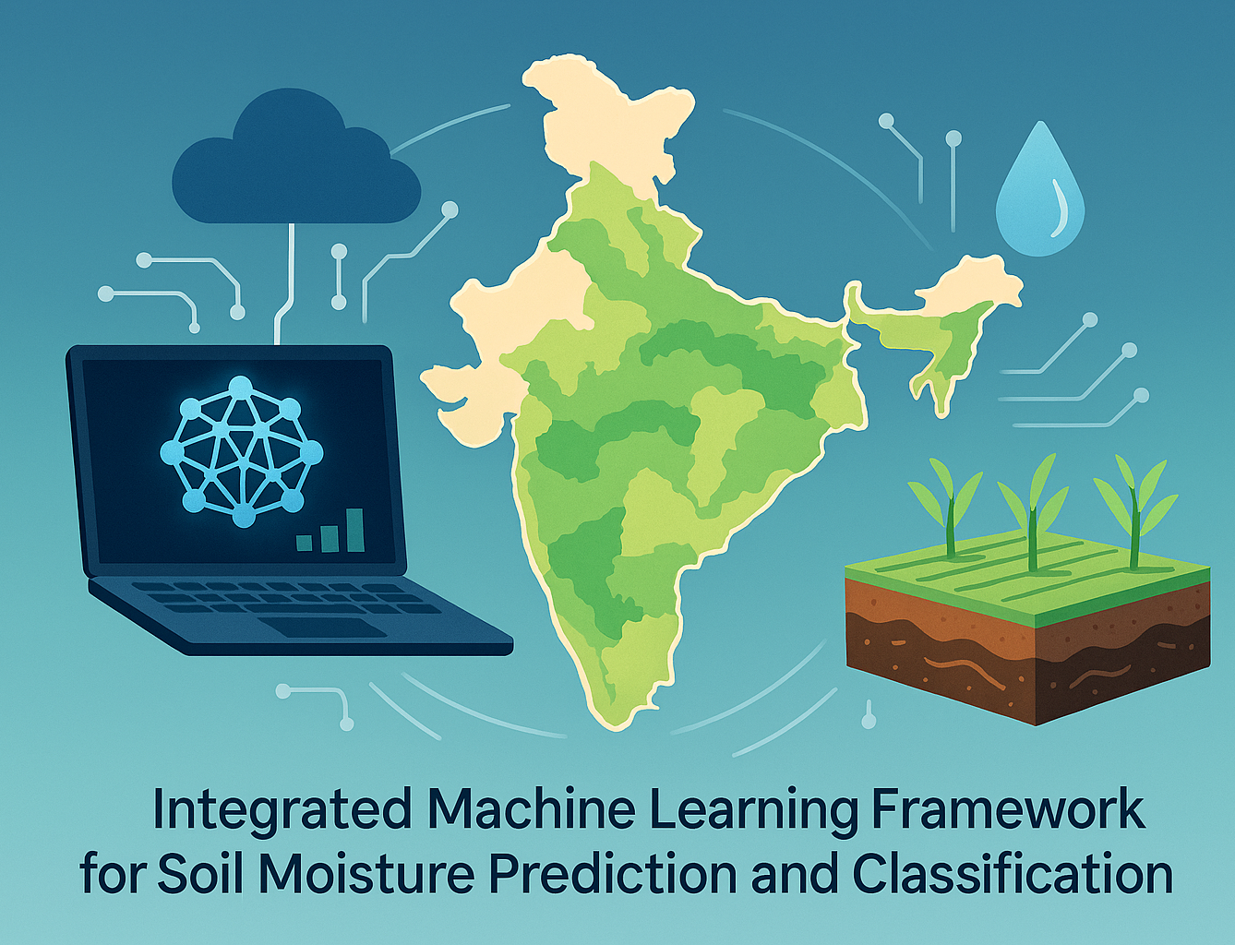
DA 204o Data Science in Practice
Team
Patel Parth Pravinkumar
Inderjit Singh Chauhan
Payal Dey

Slide 2
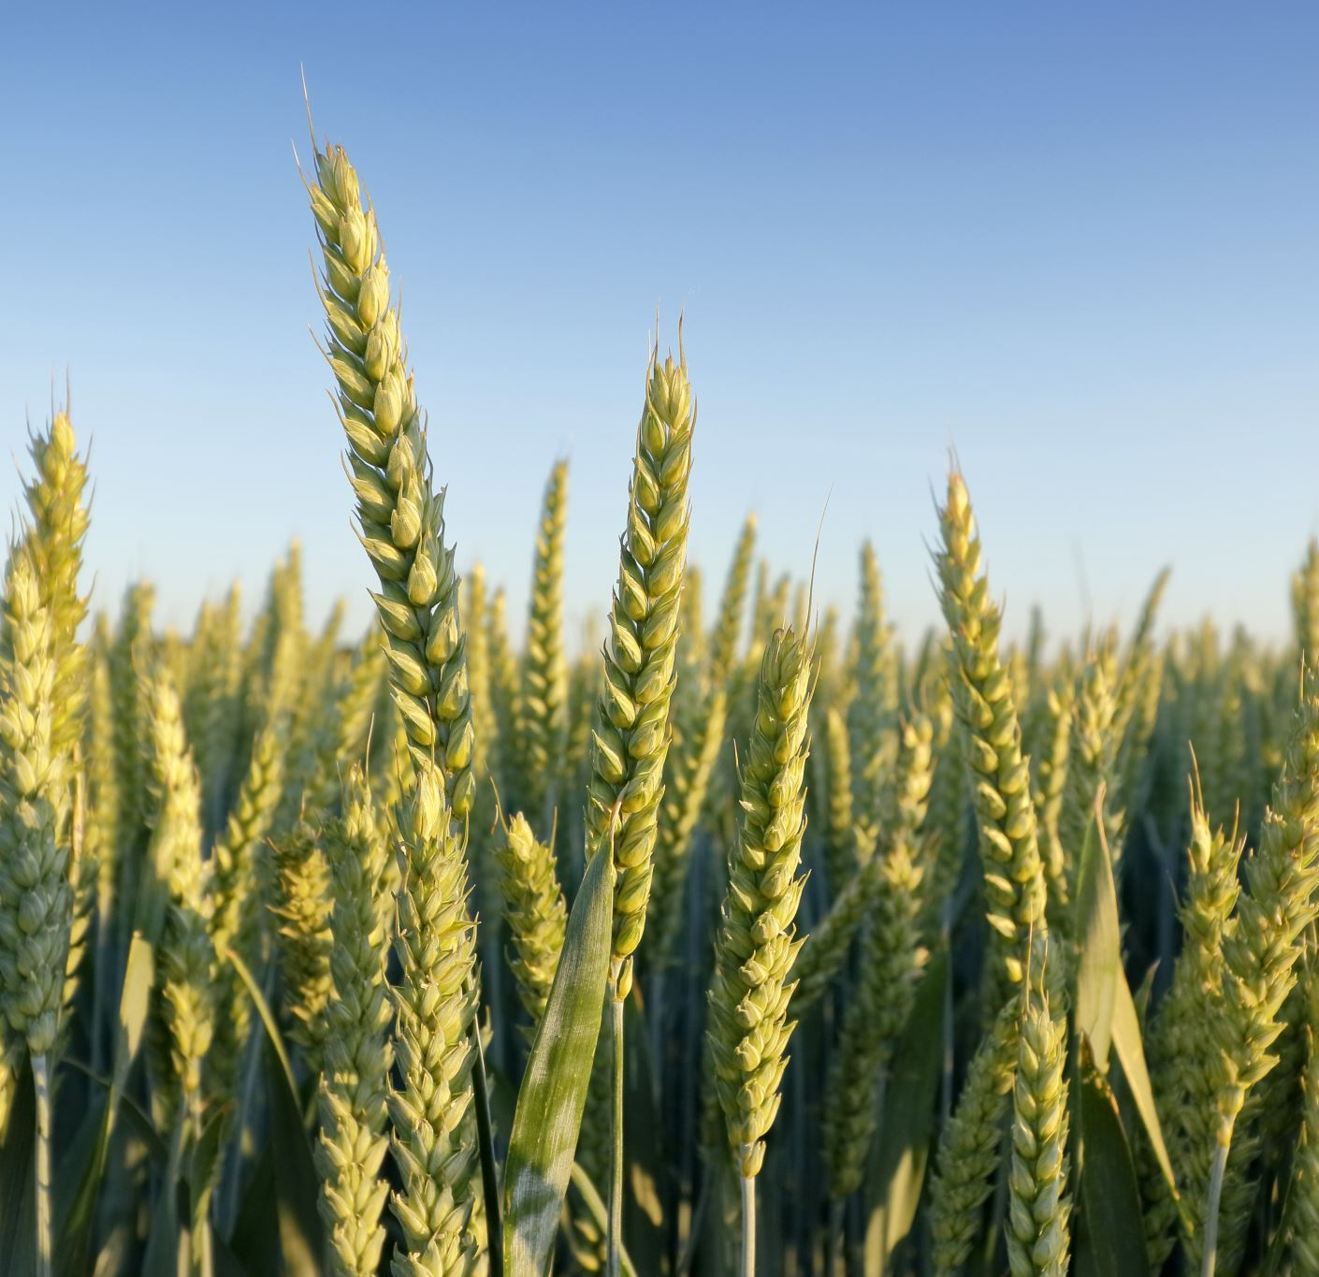
Motivation
Agriculture plays a vital role in every nation’s economy by contributing significantly to food production. Accurate identification of plant diseases, soil moisture and fertilization is one of the most critical tasks in maintaining a productive agricultural ecosystem. Early and efficient disease detection helps prevent crop loss, minimizes economic impact, and reduces unnecessary use of resources.
Deep learning has emerged as a powerful tool for assisting farmers in early detection of plant diseases through automated analysis of plant leaf images. In this study, we evaluated two models—CNN, VGG-19 and ResNet-50—using the Crop Disease and Soil Moisture dataset containing 20,000 crop images and 200 soil images. Experimental results showed that the CNN model achieved an accuracy of 82%, VGG-19 achieved accuracy of 91.25%, while the ResNet-50 model achieved a significantly higher accuracy of 95.98%, establishing its superiority in disease classification and soil analysis tasks.
Due to its strong performance, the ResNet-50 model was integrated into a Streamlit-based application designed for real-time plant disease diagnosis and soil moisture prediction. The system assists farmers by analysing crop and soil images to identify infections, classify disease types, and estimate moisture content. This application aims to enable timely preventive measures, reduce crop losses, conserve resources, and improve overall agricultural productivity.

Slide 3
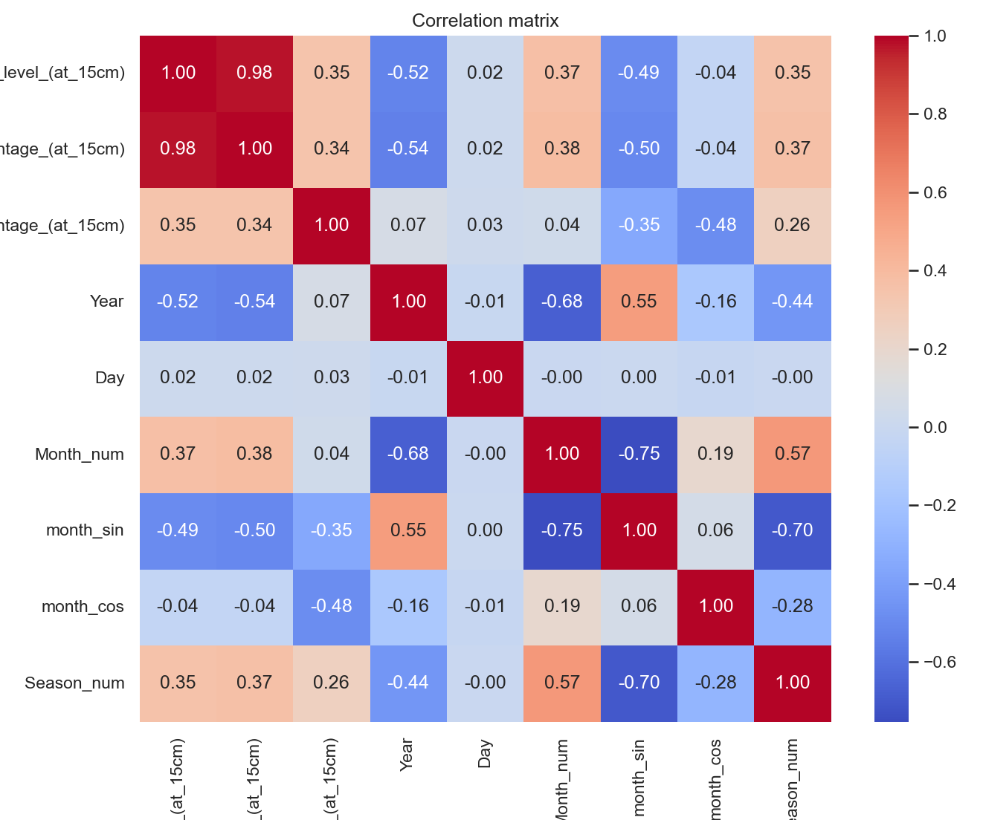
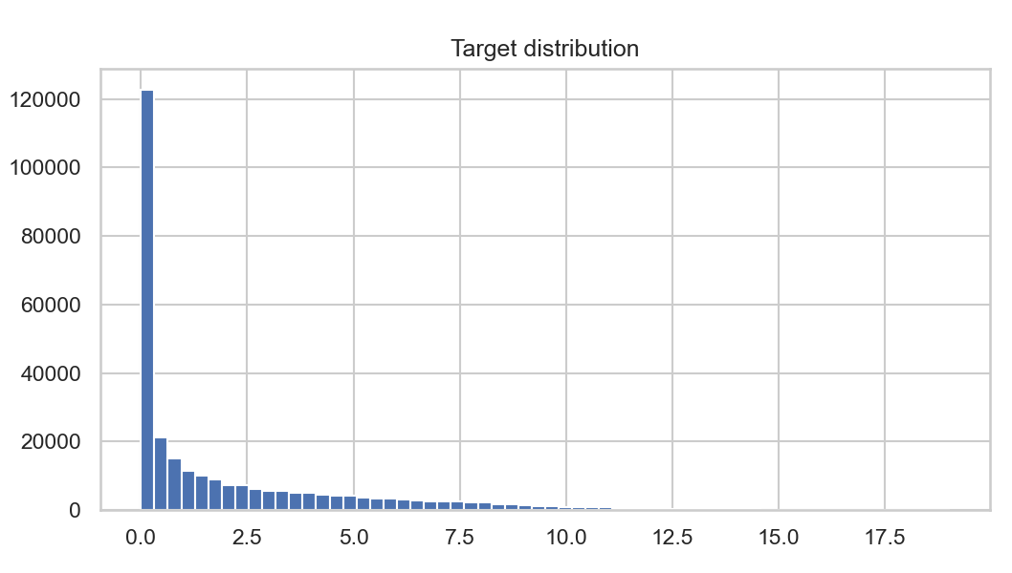
Soil Moisture Dataset Summary & Source
Dataset sourced from Government of India Open Data Portal (data.gov.in)
Publisher: ICAR – AICRP on Dryland Agriculture
Dataset: “Soil Moisture Data at 15 cm Depth (2018 & 2020)”
Total usable records after cleaning → ~150,000
Standardized fields:
State
District
Date → Year, Month, Day
Season (derived)
Engineered temporal features:
Month_num, month_sin, month_cos, Season
Moisture range in dataset: 0 → ~18.5,
distribution is right-skewed

Slide 4
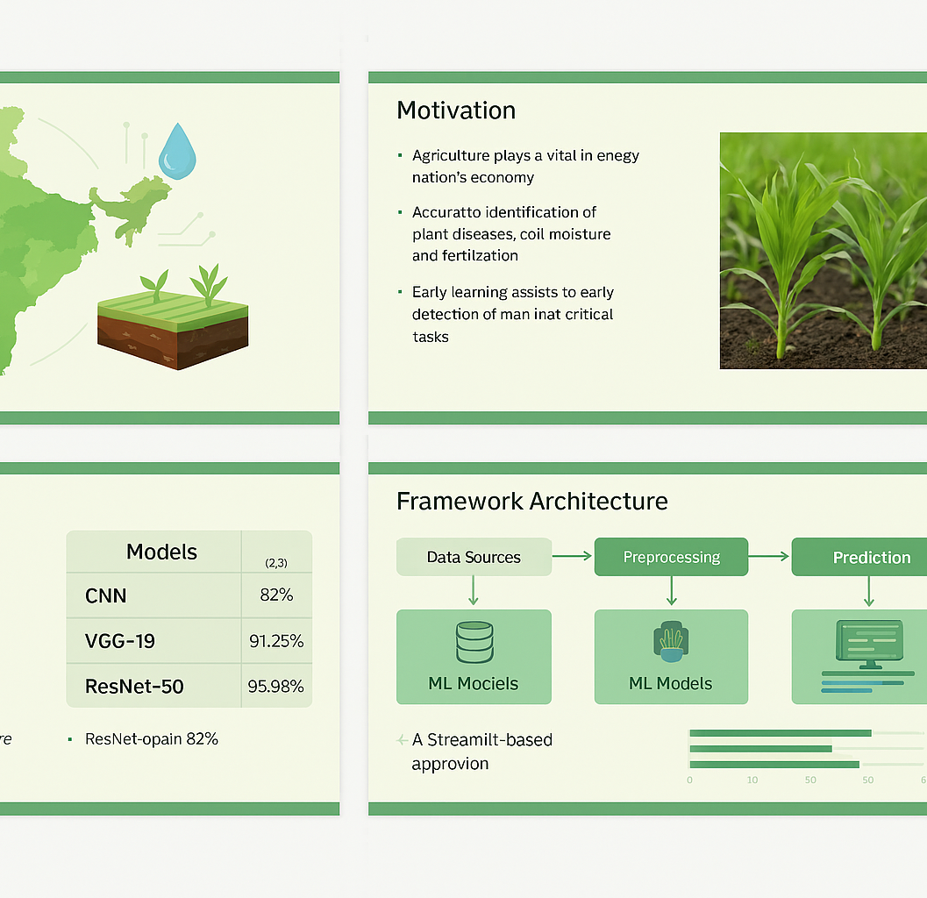
Dataset Summary (CNN)
Dataset : 20k+ Multi-Class Crop Disease Images
Description: The Crop Disease Image Dataset is a comprehensive collection of images depicting various diseases affecting major crops including wheat, maize, cotton, sugarcane, and rice. This dataset serves as a valuable resource for researchers, developers, and practitioners in the agricultural domain, facilitating the study, diagnosis, and mitigation of crop diseases. The dataset contains a diverse range of crop disease images, meticulously curated from multiple sources to ensure completeness and relevance. It encompasses images of common and rare diseases afflicting each crop, captured at different stages of development and severity.
Dataset : soil moisture dataset based on measurement
Description: There are 200 hundreds of soil surface images, from rainfed agriculture area in Bondowoso Indonesia. The images have been classified based on the soil moisture level. The moisture level is measured using soil sensor. The soil surface images that have been taken using handphone camera above 50-70 cm.

Slide 5

CNN Models
Data Flow Architecture
Dataset
Soil Moisture Prediction Plant Disease Classification
Soil Moisture Classification
Streamlit Application
Inference
User
XGBoost
Features:
Gradient boosting.
Handles missing data.
strong non-linear learning
Strengths:
Highest accuracy (RMSE 0.29).
best for seasonal and regional patterns
LightGBM
Features:
Leaf-wise boosting.
Very fast.
Low memory
Strengths:
Fast training.
Good accuracy.
Efficient for large datasets
Custom CNN
Designed a 4-block convolutional model:
Features:
Batch Normalization
Dropout in conv layers (0.1 to 0.4) to reduce overfitting
Adaptive Average Pooling
Fully connected classifier with dropout
Strengths:
Lightweight
Good for small datasets (e.g., soil moisture)
Faster training
ResNet-50 (Transfer Learning)
models.resnet50(weights="IMAGENET1K_V1")
Transfer learning strategy:
Early layers frozen (learn general features)
Later layers unfrozen (layer3, layer4)
Fully connected layer replaced.
Reason:
Deep network (50 layers)
Excellent feature extraction
Good for complex patterns (crop diseases)
VGG19 (Transfer Learning)
Feature extractor frozen
Only classifier retrained
Suitable for large multi-class dataset
Strength:
Stable, reliable model
Good for detailed leaf texture classification
Random Forest
Features:
Ensemble of decision trees
Robust to noise
Strengths:
Stable model
Good non-linear performance.
Easy to tune
Linear Regression
Features:
Simple linear model.
Interpretable
Strengths:
Fast baseline.
Weakest performance on this problem
ML Models

Slide 6
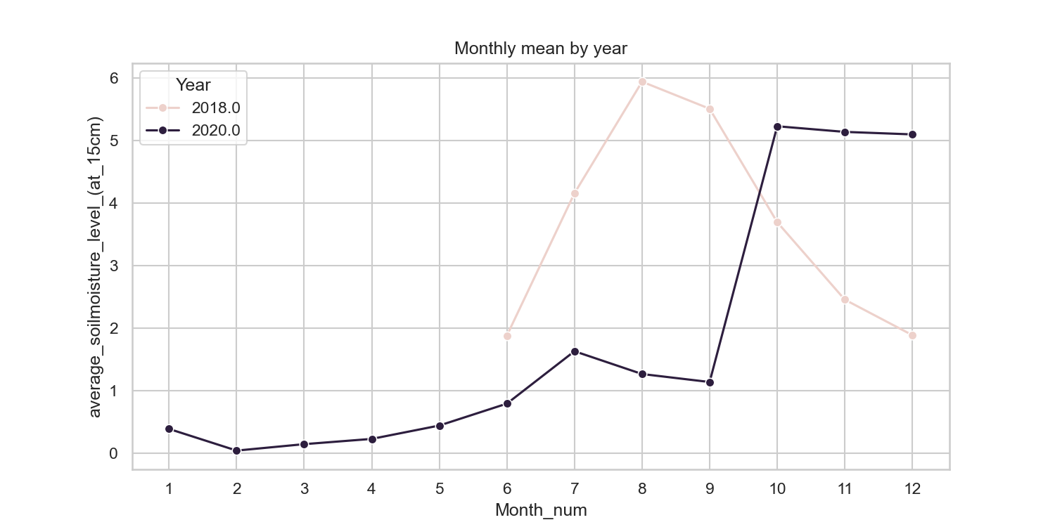
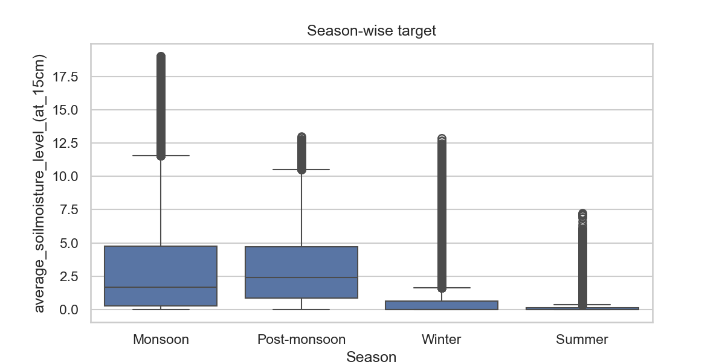
EDA Soil Moisture
Strong seasonal pattern:
Monsoon → Highest moisture
Summer → Lowest moisture
Monthly trend (2018 vs 2020):
2018 shows strong monsoon rise (~6 units)
2020 lower due to missing/incomplete sensor data
State-wise variations:
High moisture: Andaman & Nicobar, Uttarakhand, Assam
Low moisture: Ladakh, Gujarat,
Result: Season + State + District are key predictors

Slide 7

EDA Data Preparation Feature Engineering Model Training Evaluation Strategy
Image Transformations(Augmentation)
To improve generalization andreduce overfitting, both datasetsuse data augmentation:
Purpose
Simulates real-world conditions
Helps models adapt to:
different lighting
varying angles
color distortions
zoom differences
Reduces overfitting, especially insoil moisture dataset with small sample size.
Evaluation Strategy:
Accuracy
Validation Loss
Test Loss
Per-Class Accuracy
Top 3 Prediction Accuracy (for soil moisture dataset)
Confusion Matrix
Shows which classes are confused
Important for imbalanced datasets
Helps diagnose:
Misclassification patterns
Classes with poor representation
Ensemble Learning
Simple Majority Voting
Takes predictions from CNN, ResNet, VGG
Chooses majority vote
Benefit:
Improves robustness
Reduces model-specific errors
Often outperforms single models
Visualized Training Curves
Training vs validation loss
Training vs validation accuracy
Comparison across models
Useful for interpreting:
Overfitting
Underfitting
Convergence
Class Rebalancing Using Weights
Because some diseases have more images than others, class weighting was applied in the loss function:
Rare disease classes receive higher loss weight which improves recall for minority classes.
Training function computes class weights:
Purpose:
Soil moisture dataset has imbalanced classes
Weighted loss ensures under-represented classes contribute more to training
Improves per-class accuracy
Data Augmentation (Critical for Small Datasets)
Since only 200 images are available, aggressive augmentation is necessary to synthetically expand the dataset.
Transformations included:
RandomResizedCrop
Rotation (±20°)
Horizontal flips
Colour jittering
Gaussian blur
Normalization
This creates diverse training samples and reduces overfitting.
Transfer Learning
Given the dataset size, transfer learning using ResNet was applied:
Early layers frozen (detect general features)
Deeper layers finetuned (learn crop-specific disease patterns)
This drastically reduces training time and improves accuracy.
EDA and Data Preparation
Normalization
All models apply:
Normalize (mean= [0.485,0.456,0.406], std= [0.229,0.224,0.225])
Matches ImageNet normalization
Ensures model compatibility with pretrained weights (ResNet, VGG)
Train–Validation–Test Splitting
The dataset was split using stratified sampling to maintain class balance:
70% Training
15% Validation
15% Test
Stratification is important because some classes have fewer samples than others.
Training Strategy:
1. Optimizer
optim.AdamW(lr = 1e-3 or 1e-4)
AdamW prevents weight decay issues
Works well with deep networks
2. Learning Rate Scheduler
Automatically reduces LR if validation loss stagnates
Helps models escape local minima
Improves convergence stability
3. Early Stopping
Stops training when no improvement
Prevents overfitting
Saves the best model checkpoint

Slide 8
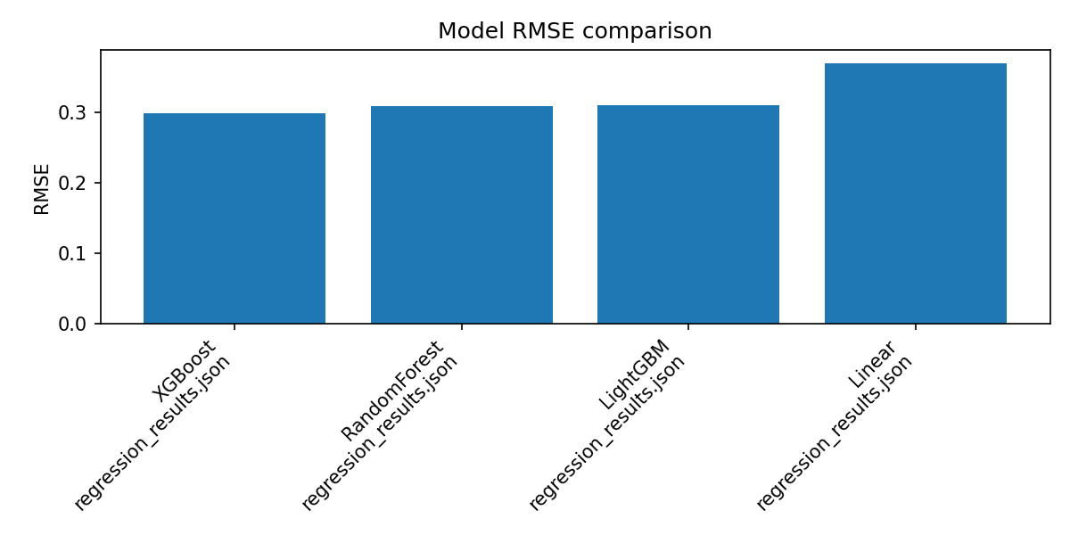
ML Model for Soil Moisture Prediction
Features used:
Temporal:
Month_num, month_sin, month_cos
Season
Geographic:
Encoded State
Encoded District
Why not use raw moisture columns?
2018 & 2020 have inconsistent sensors, missing values (0 or “-”), unit mismatches.
Engineered features give stable, year-independent performance.
Model Comparison:
XGBoost — Best performance
RandomForest, LightGBM — good
Linear Regression — poor fit
Final Metrics:
RMSE = 0.29
NRMSE ≈ 12.6%
mMAPE ≈ 8.5%

Slide 9
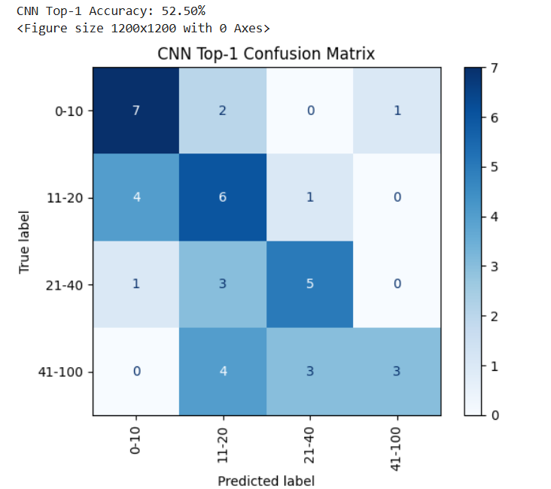
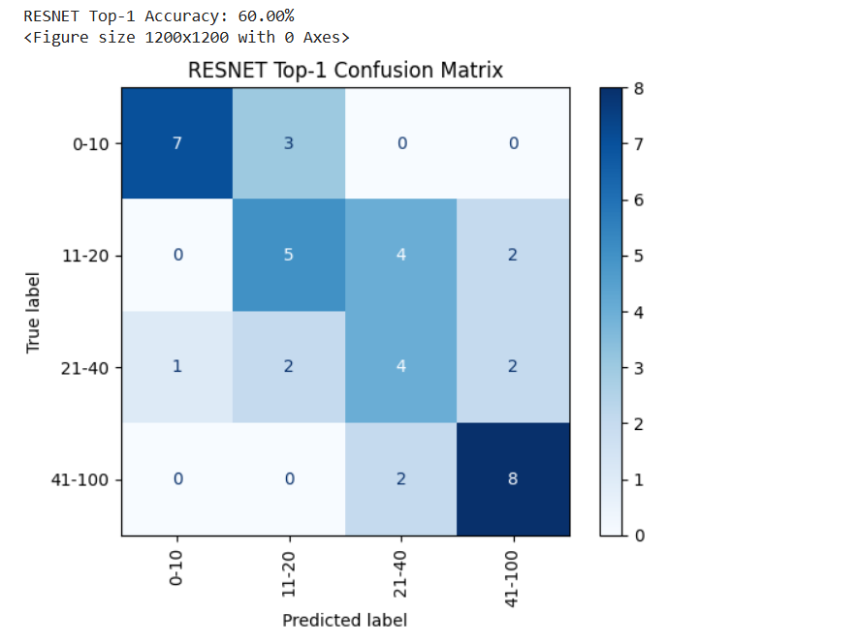
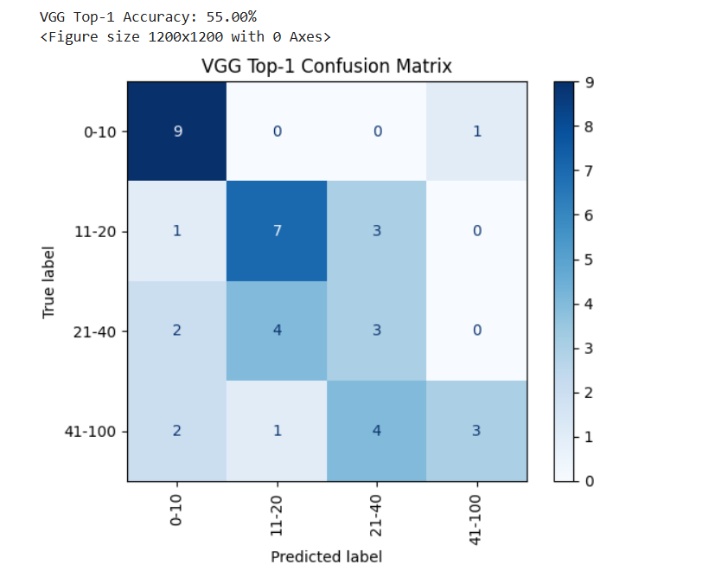
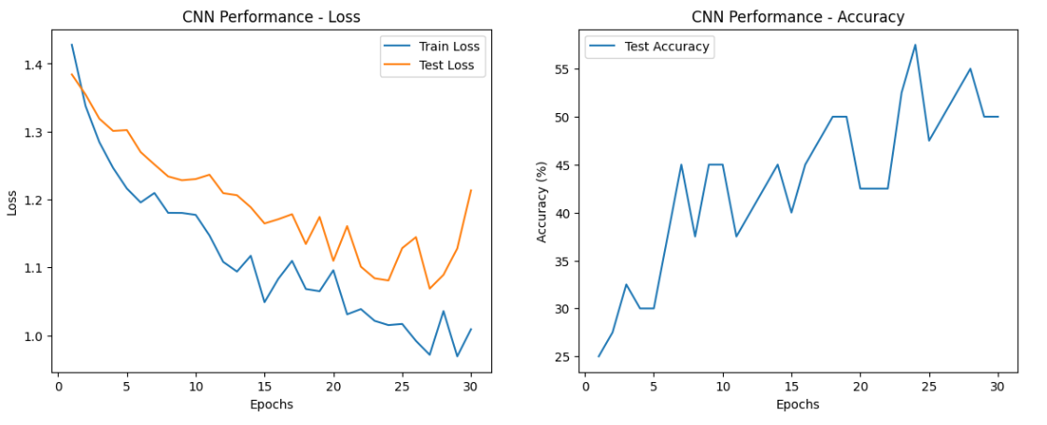
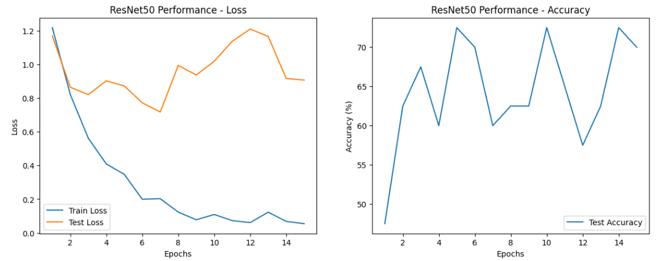
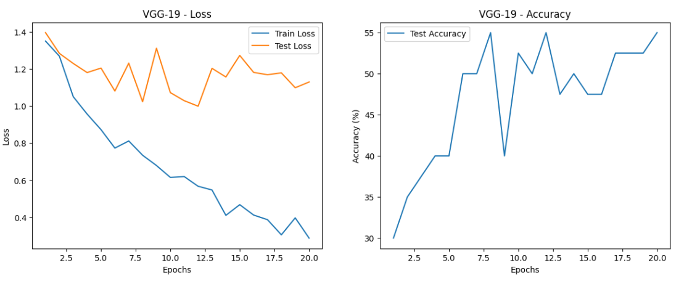
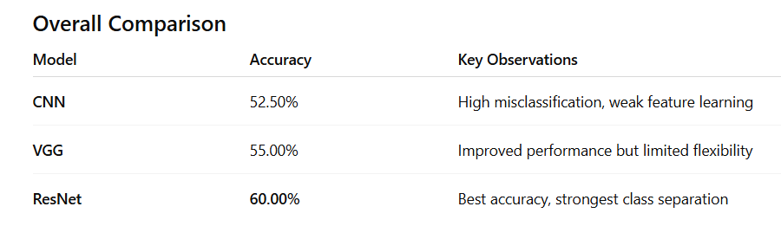
Results and Insights
Soil Moisture Classification
The confusion matrix illustrate how well each model classified images into four categories: 0–10, 11–20, 21–40, and 41–100 (likely representing levels such as disease severity or age groups of plants). The diagonal values represent correct predictions, while off-diagonal values represent misclassifications.
Key Insights:
CNN’s basic architecture is insufficient for capturing complex patterns and results in low classification performance.
ResNet: The deeper architecture with skip connections enables better feature extraction and improved accuracy compared to CNN.
VGG performs moderately well but falls short of ResNet due to more rigid architecture and lack of skip-connections that help avoid vanishing gradient issues.
CNN Performance
CNN struggles to generalize and exhibits overfitting due to shallow architecture and limited feature extraction capability.
ResNet-50 Performance
ResNet-50 learns deeper features effectively due to residual connections, achieving the best performance but still showing mild overfitting.
VGG-19 Performance
VGG-19 performs better than CNN but worse than ResNet-50, likely due to deeper but rigid architecture without skip connections.

Slide 10
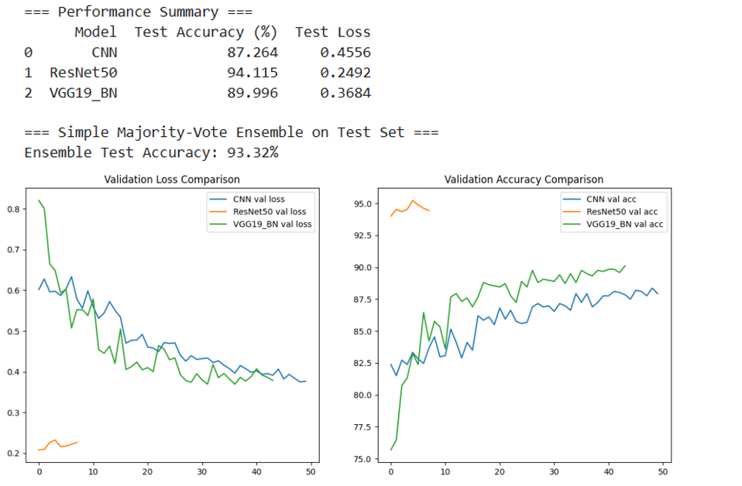
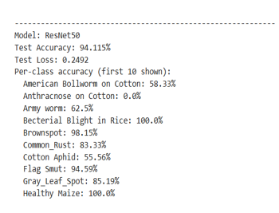
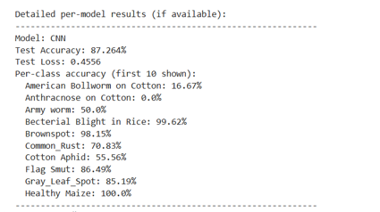
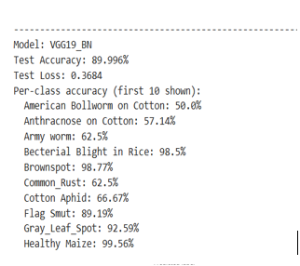
Plant Disease Classification
Simple Majority Vote Ensemble
It is an ensemble method where multiple models each make a prediction, and the final prediction is the class that receives the most votes.
Ensemble Model Insight
Simple Majority-Vote Ensemble Test Accuracy: 93.32%
The ensemble accuracy is higher than CNN and VGG19, but slightly lower than ResNet50.
This suggests that while combining predictions from multiple models improves robustness, ResNet50 alone is already performing exceptionally well.
Ensembles reduce bias and variance, making final predictions more stable.
Even though ResNet50 individually performs best, the ensemble provides a balanced, more reliable prediction model that may handle outlier cases better.
Validation Loss Comparison
ResNet50 has the lowest validation loss, meaning it learns more efficiently and avoids overfitting better than the other models.
CNN and VGG19_BN show higher initial loss, especially CNN.
VGG19_BN loss decreases significantly over time, indicating good learning stability.
Lower validation loss = better generalization and reduced overfitting.
Validation Accuracy Comparison
ResNet50 maintains the highest and most stable validation accuracy throughout training, close to 95%.
VGG19_BN accuracy steadily improves and levels around 89–90%, better than CNN, but below ResNet50.
CNN accuracy is the lowest and more unstable, showing difficulty in learning complex representations.
ResNet50 clearly leads in accuracy performance over entire training.
Plant Disease Classification:

Slide 11
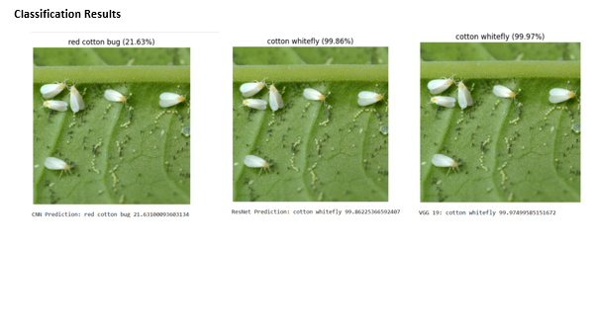
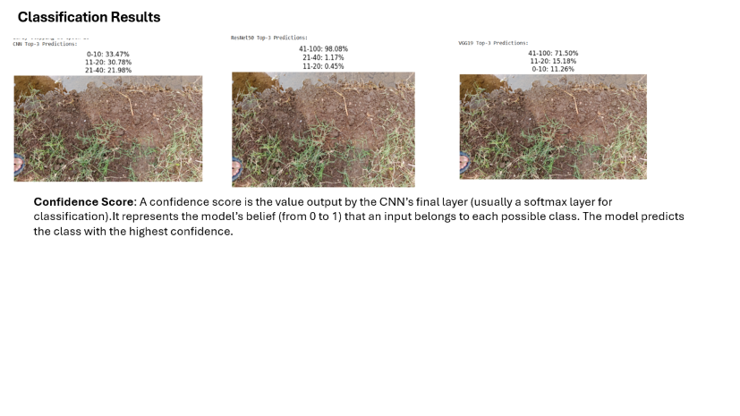
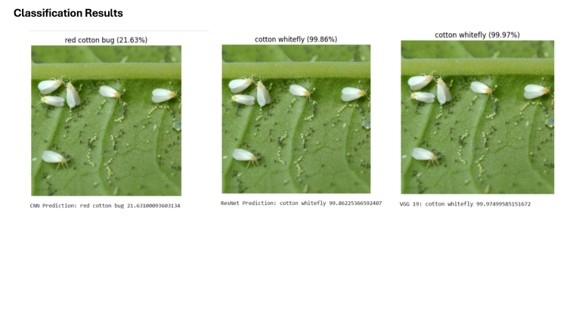
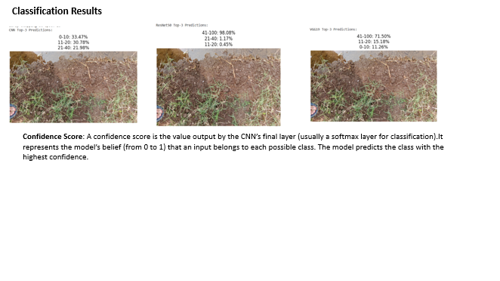
CNN Classification Result
Soil Moisture Classification
Plant Disease Classification

Slide 12
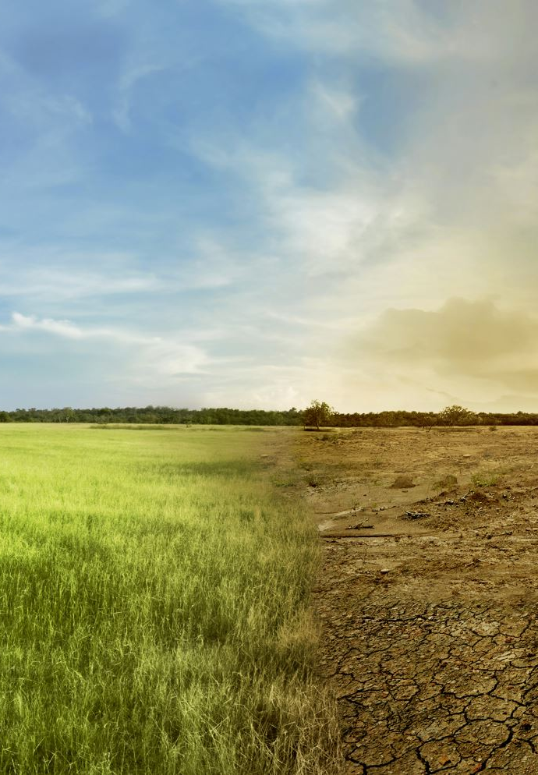
Limitations and Future Roadmap
Limitation:
Model does not include real-time weather (rainfall, humidity, temperature).
Soil moisture sensors across years use different calibration → reduces precision.
District-level predictions assume uniform soil conditions (not farm-specific).
LLM suggestions depend on API availability and may generate variable plans.
Predictions are based only on temporal + geographic patterns, not soil chemistry.
Scope:
Model does not include real-time weather (rainfall, humidity, temperature).
Soil moisture sensors across years use different calibration → reduces precision.
District-level predictions assume uniform soil conditions (not farm-specific).
LLM suggestions depend on API availability and may generate variable plans.
Predictions are based only on temporal + geographic patterns, not soil chemistry.

Slide 13
Future Improvements:
Model Improvements
Advanced Deep Learning Architectures
EfficientNetV2 / ConvNeXt for more modern, efficient features.
Vision Transformers (ViT / Swin Transformer) to capture global patterns better than CNNs.
Self-supervised learning techniques (SimCLR, MAE) to learn features without labelled data.
Model Optimization
Hyperparameter tuning (Optuna)
Contrastive learning for soil texture representation
Lightweight models for mobile deployment
Real-time Inference Tools
Build a lightweight model for smartphones or handheld sensors.
Deploy as:
Mobile App (Android/iOS)
Web inference dashboard
IoT integration for farms
Multi-Task Learning
Future models can perform multiple tasks simultaneously:
Disease classification
Disease severity estimation
Leaf segmentation
Moisture level estimation This improves efficiency and overall performance.
Limitations (CNN)
Soil Moisture Dataset
Very small dataset (~200 images): Limits the model’s ability to learn generalized patterns.
High similarity between classes: Moisture levels visually appear very close, making classification challenging.
Environmental noise: Shadows, phone camera variation, and soil surface disturbances affect texture-based predictions.
Single-location data: All samples coming from Bondowoso, Indonesia that can lead to poor generalization to other soil types.
Model & Methodological Limitations
Overfitting in small dataset: Even with augmentation, deep models (ResNet, VGG) risk overfitting the soil moisture dataset.
Limited explainability: CNN-based models behave as black boxes; limited insight into what features drive predictions.
Transfer learning limitations: Pretrained ImageNet models may not optimally capture crop-specific or soil-specific texture patterns.
No temporal or sensor fusion: Soil moisture predictions rely only on images, ignoring additional useful sensor data.
Computational cost:
VGG19 and ResNet are heavy models.
Training ensembles increases computation even more.
Evaluation Limitations
Single test set for crop disease dataset: Does not capture seasonal variation or unseen disease conditions.
Cross-validation only on soil dataset: Improves reliability but still limited by dataset size.
Lack of robustness testing: No adversarial noise testing, low-light conditions, or real-field deployment testing.

Slide 14
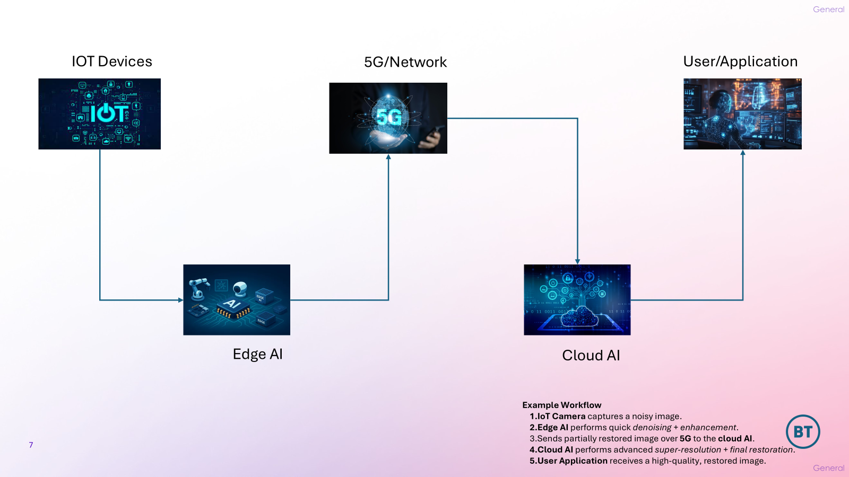
Notes:
Source: Google

Slide 15
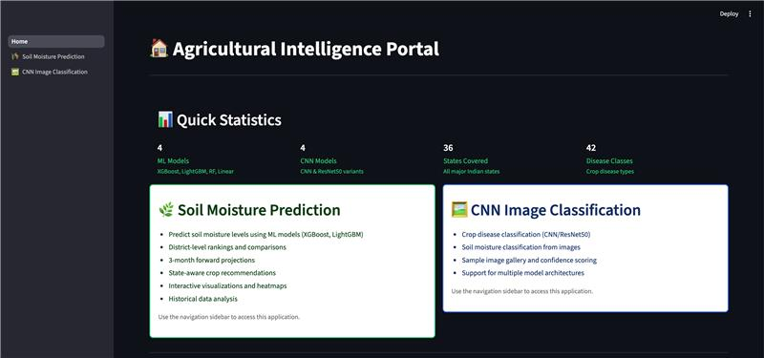
Application Portal Demo

Slide 16
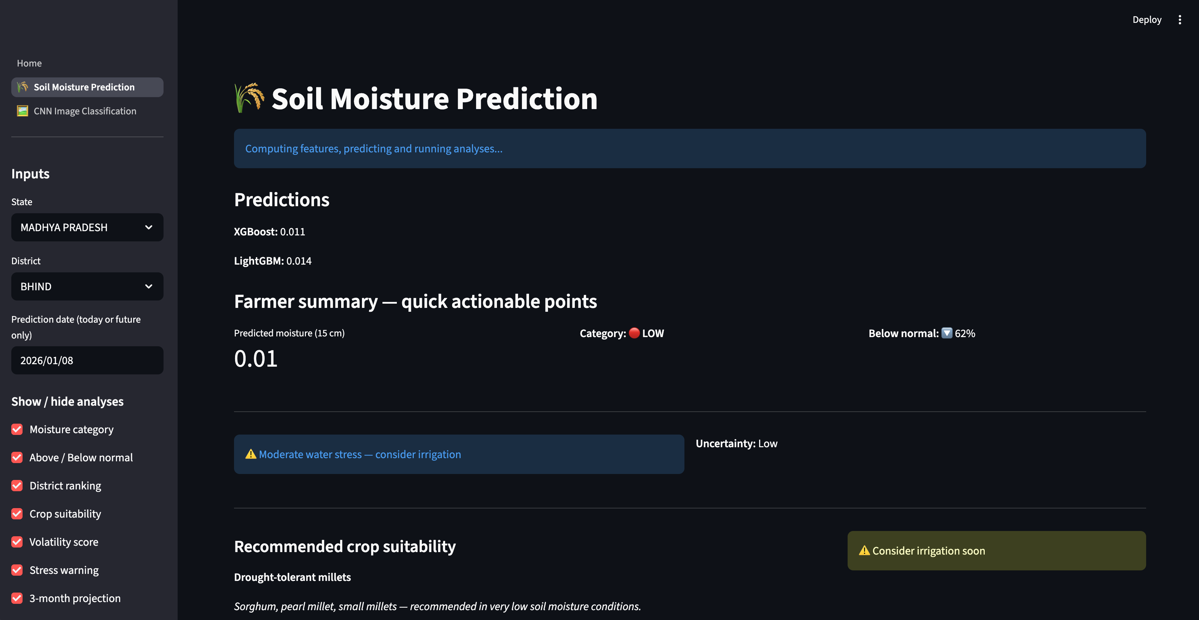

Slide 17
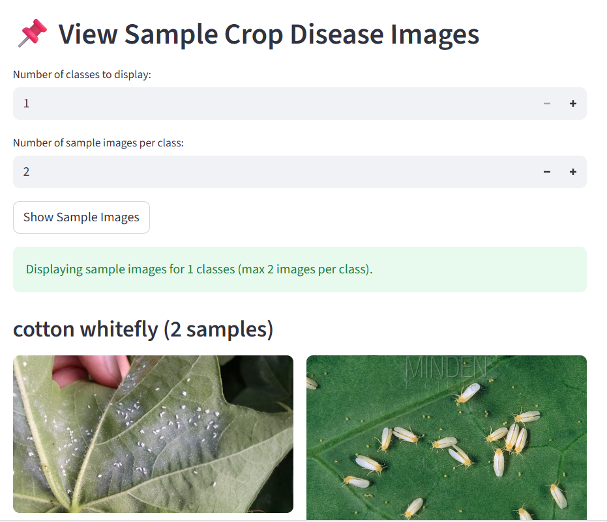

Slide 18
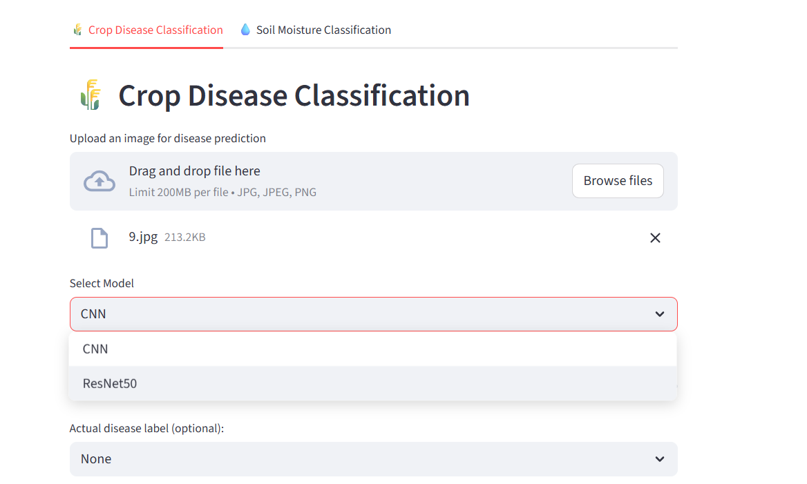

Slide 19
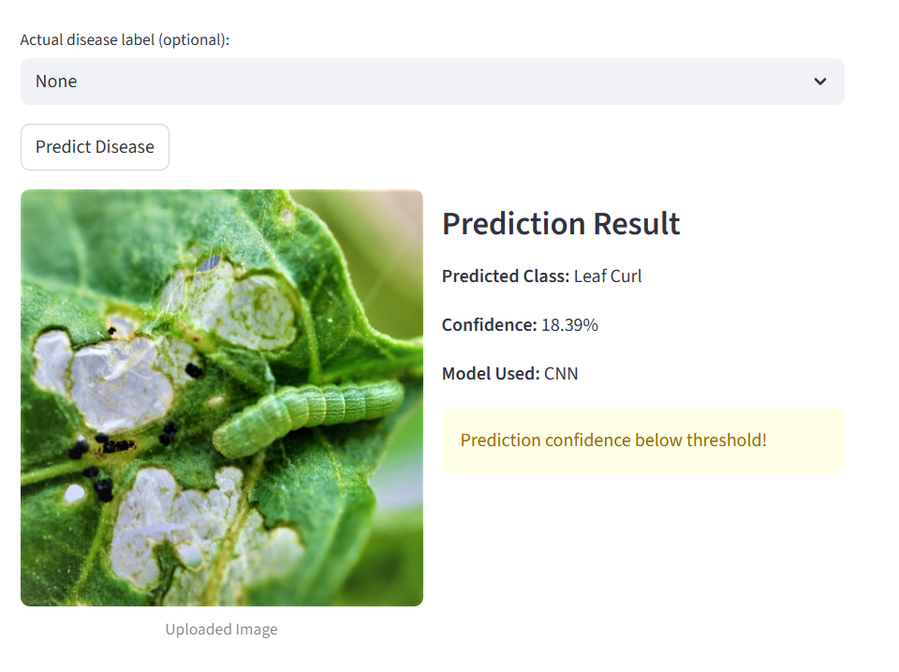

Slide 20
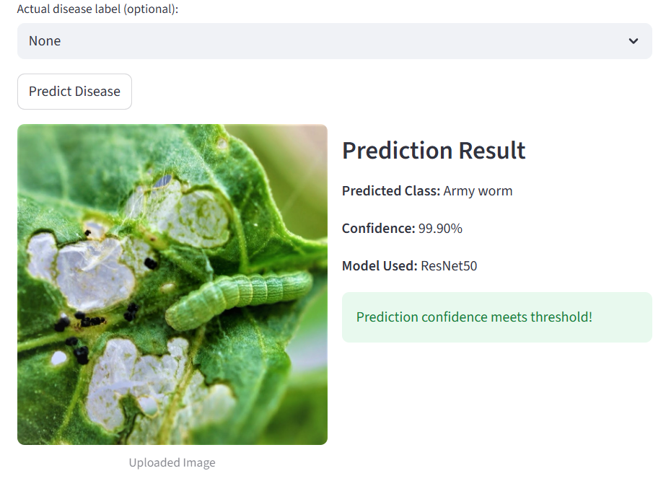

Slide 21
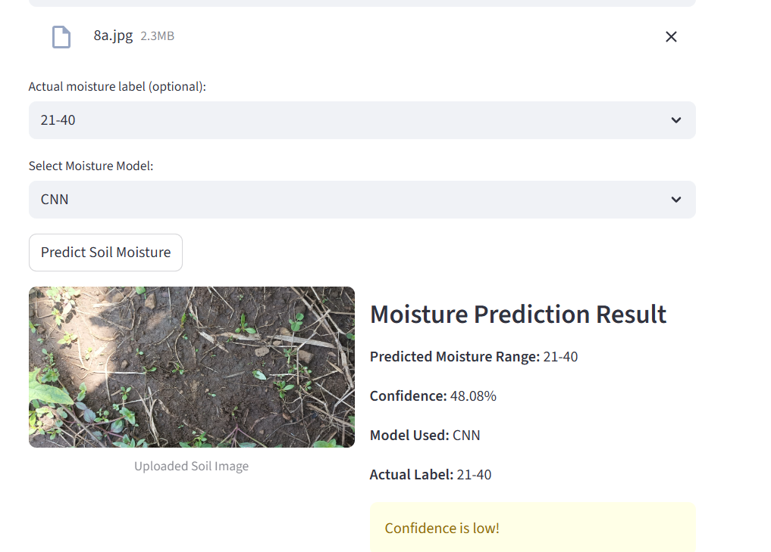

Slide 22
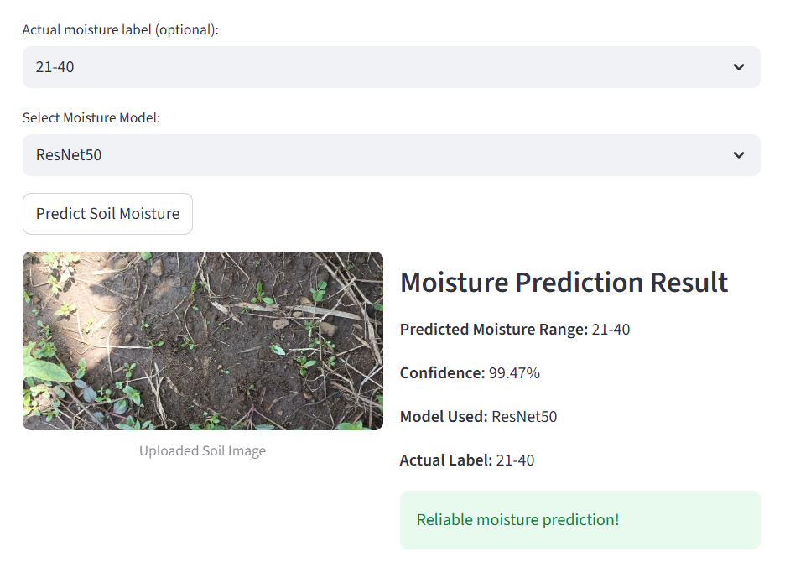

Slide 23


Slide 24
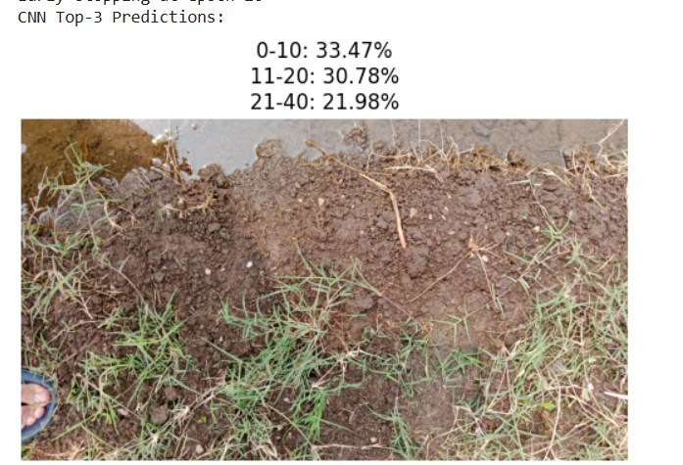
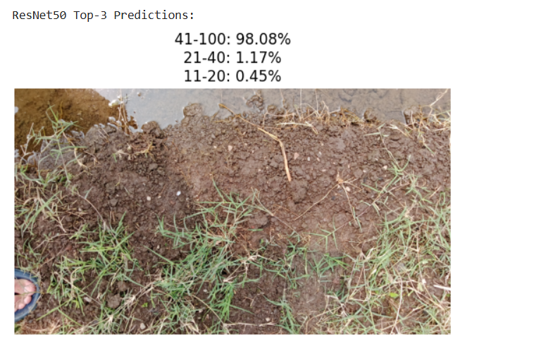
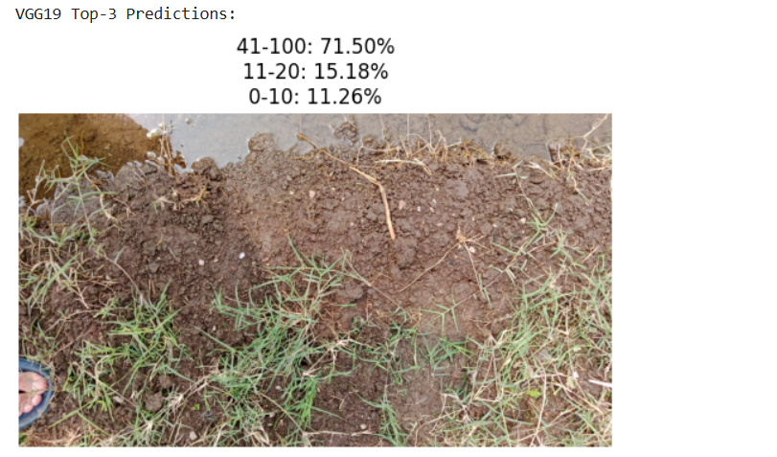
Classification Results
Confidence Score: A confidence score is the value output by the CNN’s final layer (usually a softmax layer for classification).It represents the model’s belief (from 0 to 1) that an input belongs to each possible class. The model predicts the class with the highest confidence.

Slide 25
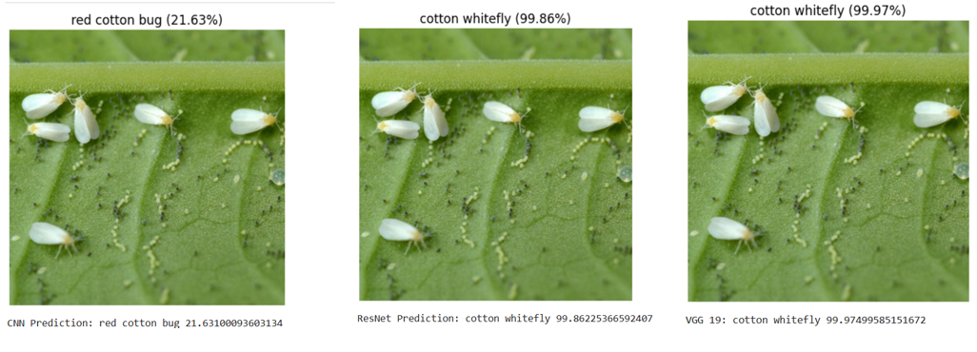
Classification Results

